Slide 1

GA6-240202501-AA1-EV02 Video
Ingeniera de software
Alumna: Heidy Dayana Otagrí Rodriguez
Instructura: Jeimmy Calderon Castillo
Program: Software Analysis and Development

Slide 2

Technology as an evolving process
INTRODTechnology as an evolutionary processUCCIÓN
Technology is undeniably the driving force behind the ongoing evolution of software engineering. It serves as both the catalyst and enabler for innovation. The rapid development of new hardware, software, and networking capabilities has not only broadened the horizons of what is possible in software design but has also pushed the boundaries of scalability and performance.

Slide 3



Automation is transforming software engineering
Automation is profoundly reshaping the software engineering landscape. It has the power to streamline repetitive tasks, enhance testing processes, and expedite deployments.
With the advent of DevOps and continuous integration/continuous deployment (CI/CD), automation is becoming an integral component of software development, ensuring rapid and reliable software delivery while reducing human error.

Slide 4
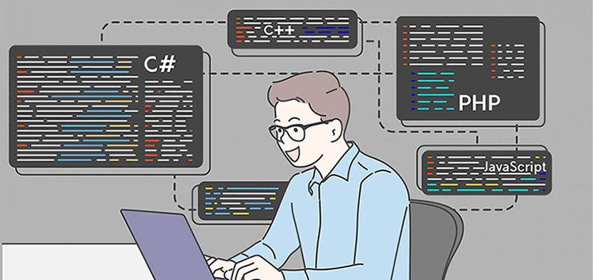
Artificial Intelligence (AI) and Machine Learning (ML) are revolutionizing software engineering by introducing intelligent decision-making capabilities and optimization processes. These technologies are transforming how we approach data analysis, predictive maintenance, and user personalization. In the development of software, AI and ML empower engineers to create smarter, more adaptive applications that cater to user preferences and provide valuable insights.
AI and AM in Software Development

Slide 5

Cultural variations in the evolutionary process of technology.
Amazon Web Services (AWS): Silicon Valley-based Amazon has transformed its cloud computing service, AWS. It has expanded its range of services to include AI, Internet of Things (IoT) and advanced analytics solutions, reflecting the ongoing evolution in cloud and technology infrastructure.

Slide 6

Cultural variations in the evolutionary process of technology.
Toyota Production System (TPS): In Japan, traditional business culture has influenced the evolution of TPS, which is a highly efficient production system. While technology has evolved in terms of automation and robotics, the core philosophy of TPS, focused on continuous improvement and quality, has remained constant.

Slide 7


Conclusión
Technology, including Artificial Intelligence and automation, is an evolutionary process in software engineering. These tools continually transform the way we address challenges, optimize processes and improve decision making. This constant evolution enables the creation of smarter and more adaptive software, which puts software engineers who adopt them in a leadership position in the field. Efficiency and innovation are key in this evolutionary process.

